Slide 1


Slide 2
The Problem
Dietary Restrictions are on the rise
More and more people are developing allergies or intolerances
Solutions are inefficient in catering to those with restrictions
Users have to manually filter through to find places that have food options readily available for them or are able to make substitutions without a hassle
People trust in other people, not technology
What is the design problem being addressed here?
Notes:
In canada alone, 2.6million people report having at least one food allergy.

Slide 3
Who are we designing for?

Slide 4





Users and Stakeholders
Users: People with (and without) Dietary Restrictions
Restaurants
Servers
Our Team

Slide 5
User Research

Slide 6
Method 1: User Survey
Understand the issues users face, how they currently deal with the issue, get a general sense of the problem.
Method 2: Server Interviews
Would this product help attain efficient service and yield more happy customers?
Method 3: Empathy Tools
How is service different with actual food restrictions?

Slide 7
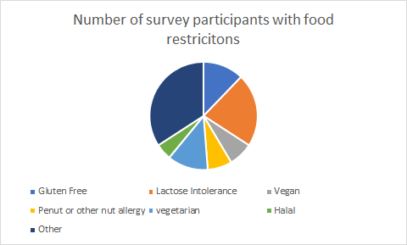
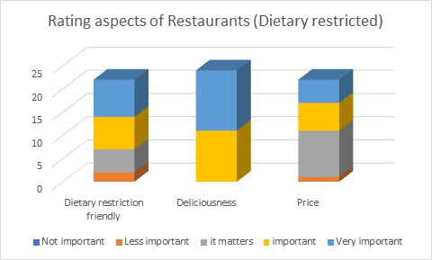
User Surveys
49 responses - 71% with food restrictions
How do we implement these important aspects in our product?

Slide 8

Increased communication points
Minimal knowledge of the ingredients
Server Interviews
Time Consuming and inefficient

Slide 9

Not Efficient
Empathy Tools
Misinformation about restrictions
Taste impacted

Slide 10
Summary of User Research
User Survey
Make the application user review based.
Server Interviews
Accessible prior knowledge for users would help with efficiency and experience of restaurant service
Empathy Tools
Confirmed the methods above.

Slide 11
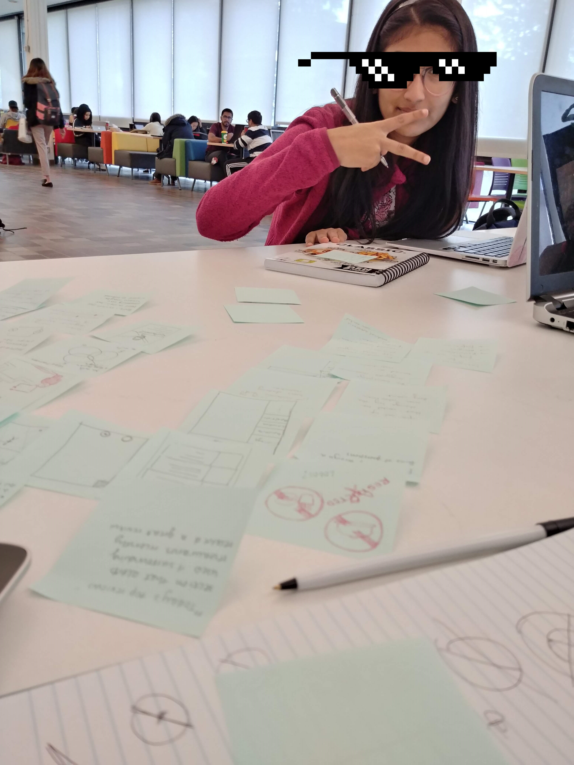
Brainstorming &
Affinity Diagramming

Slide 12
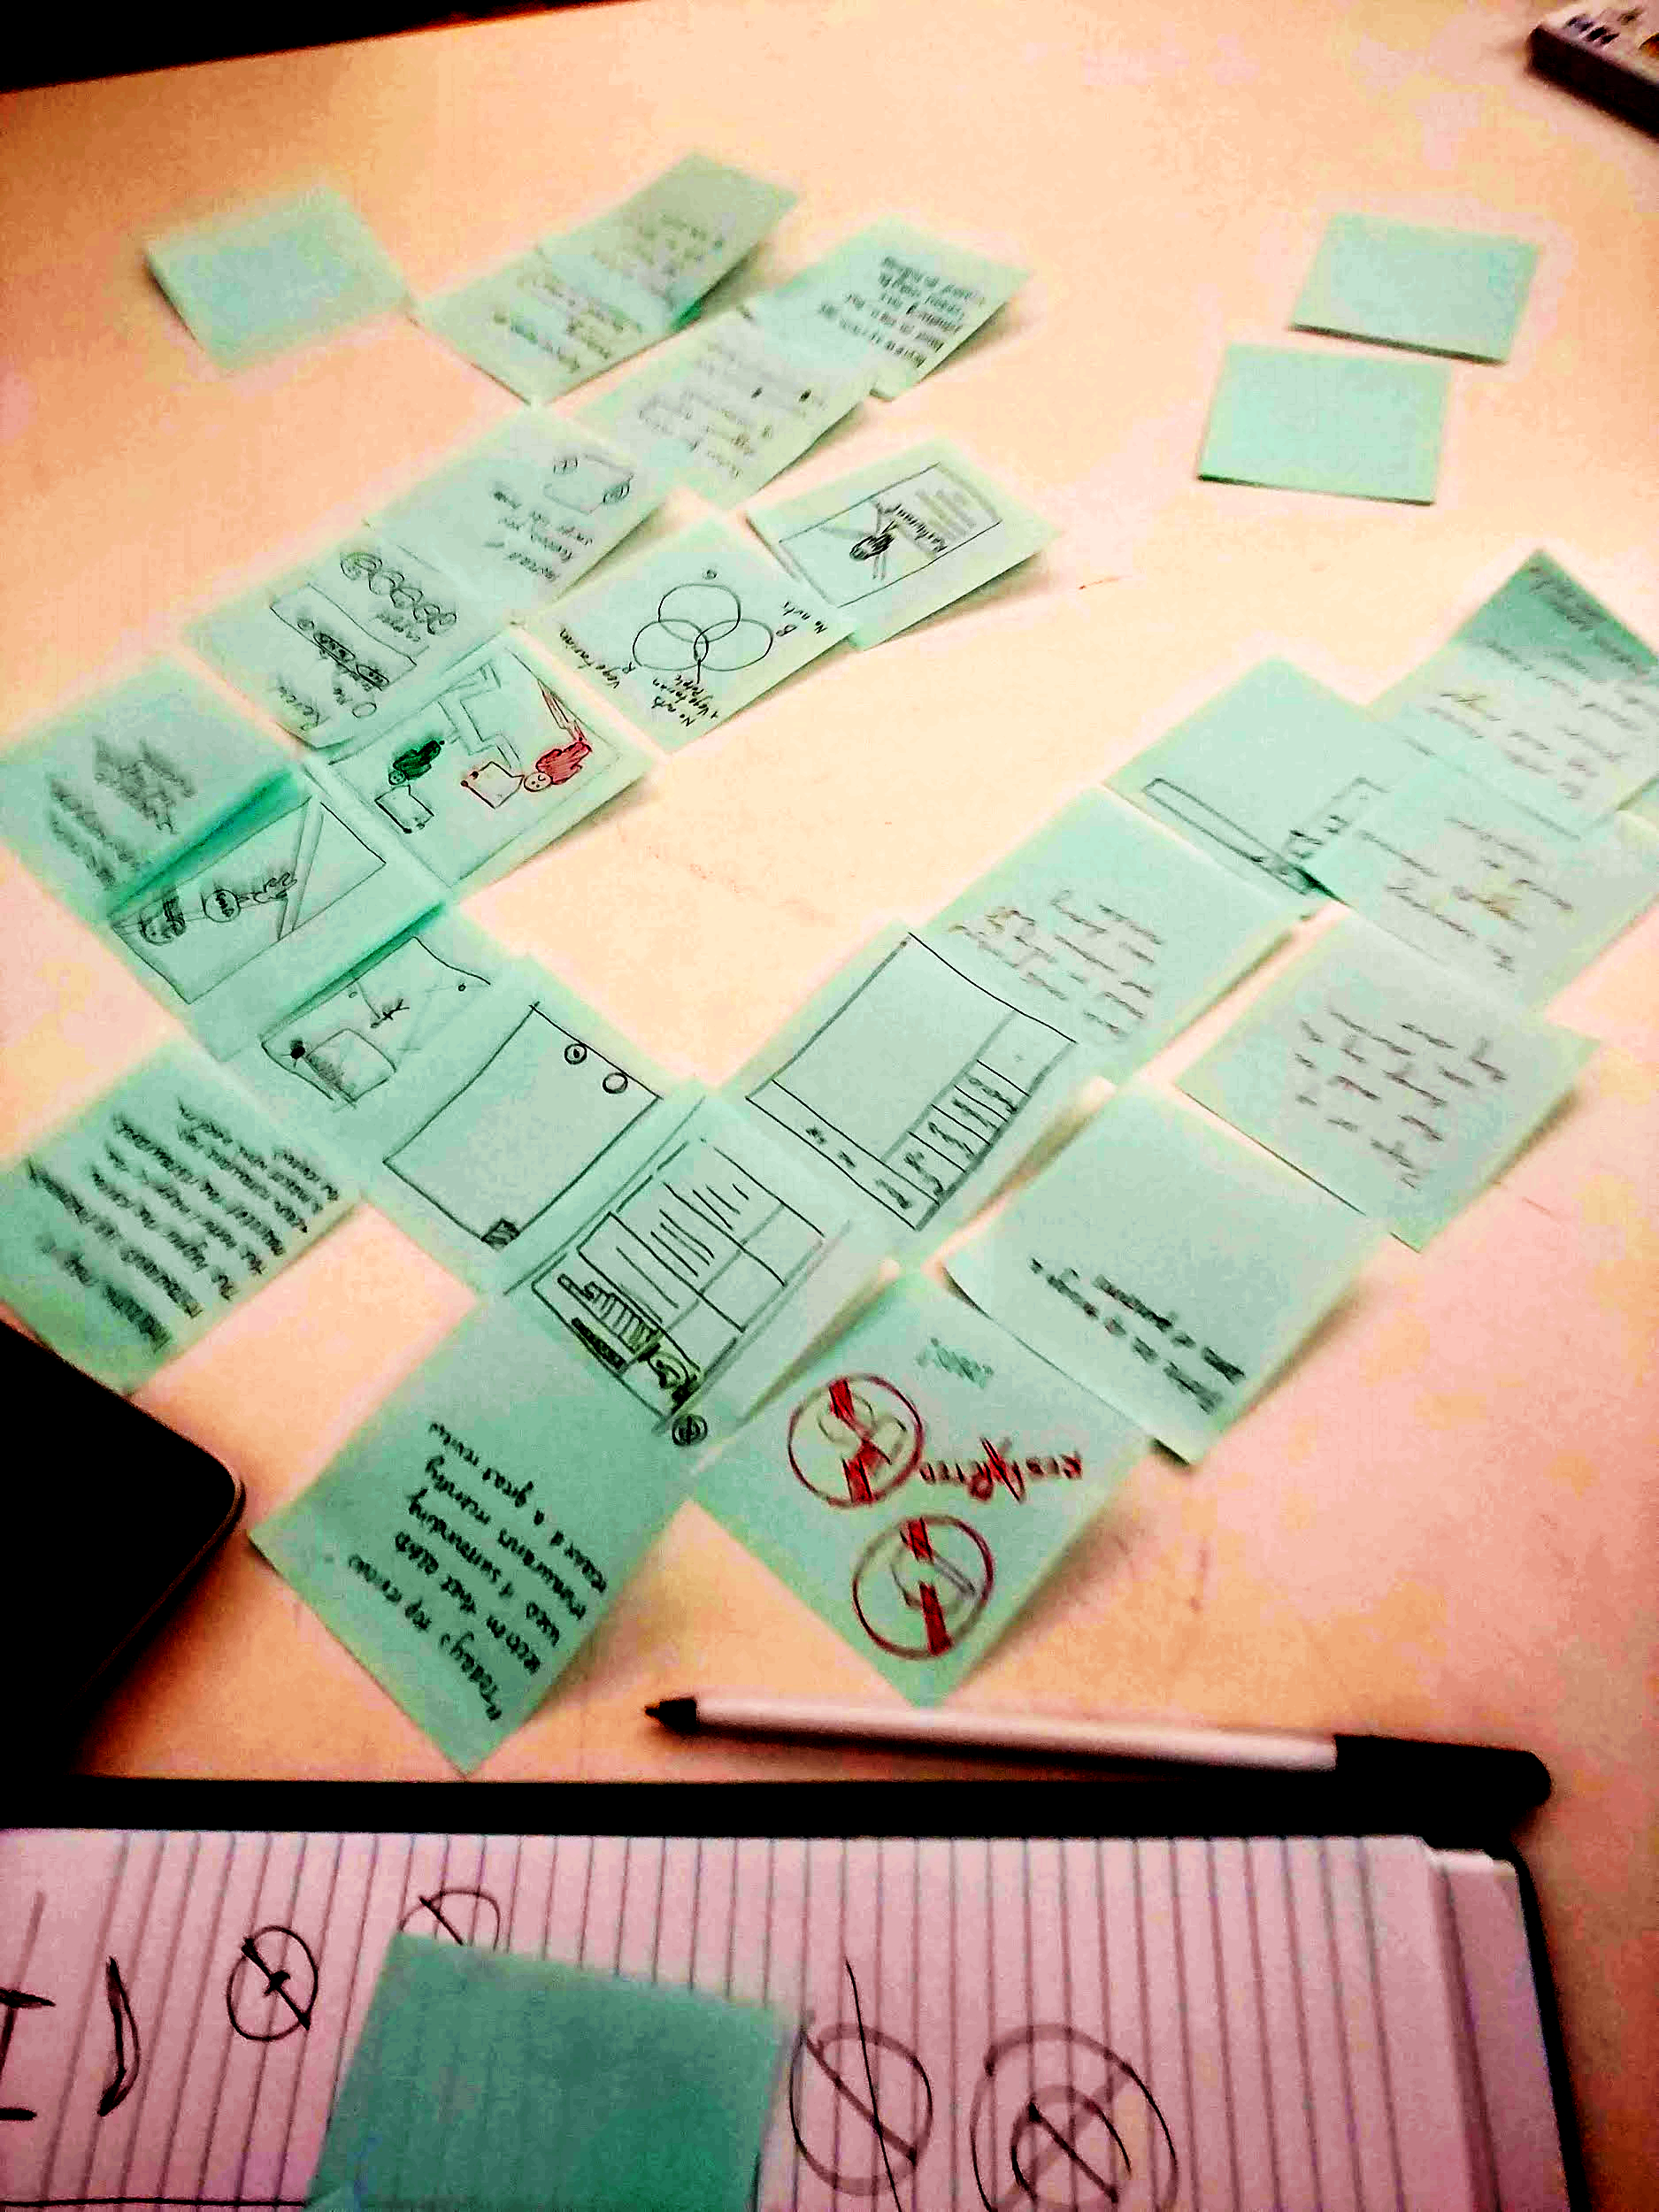
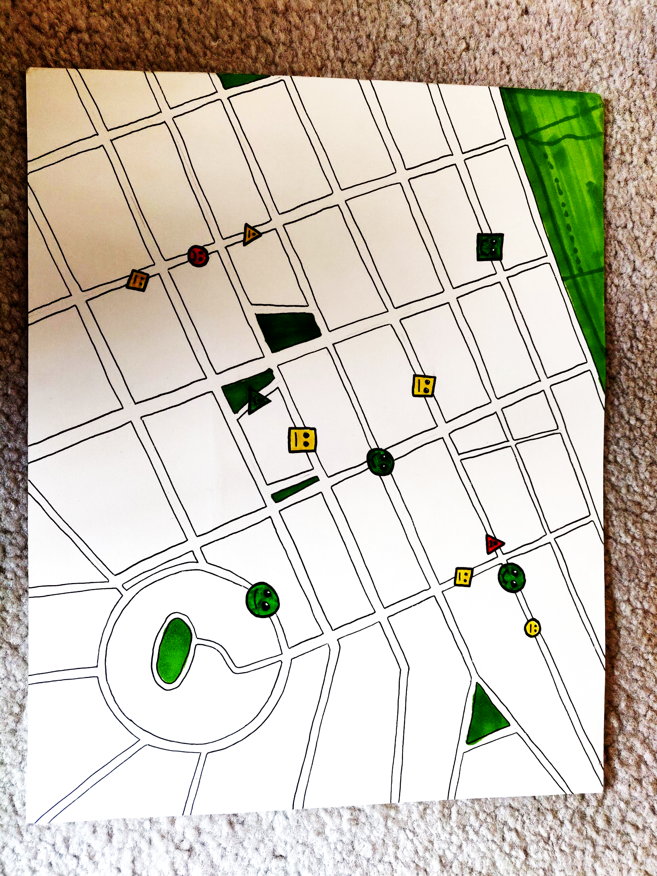
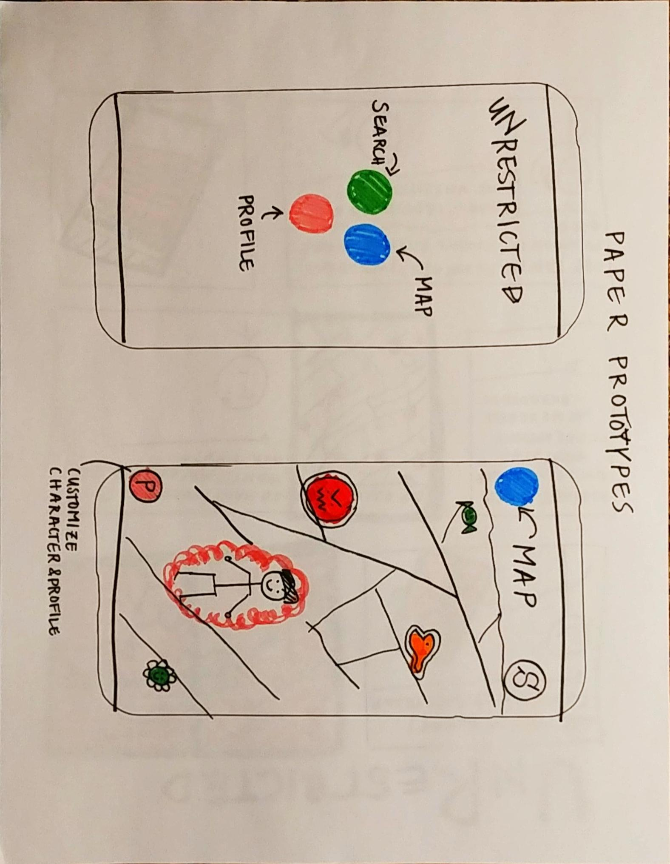
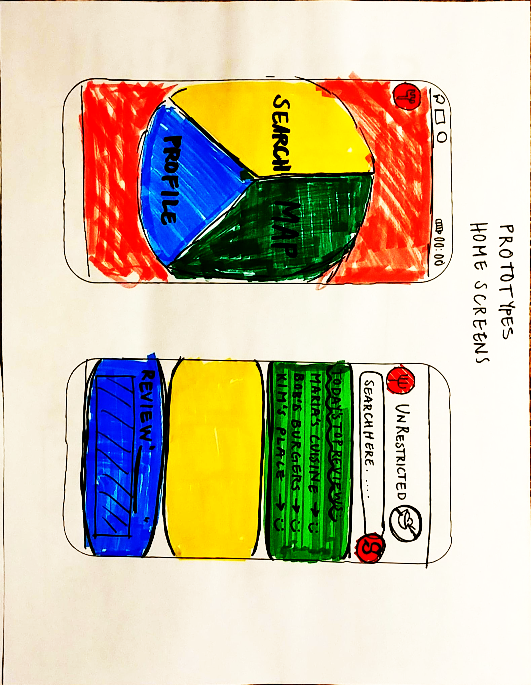
Map to view location
Icons to convey reviews
Three panel view

Slide 13
Decision Time

Slide 14
Major Design Decisions and Why
Minimalism and Simplicity
Map View
User Review Based
Notes:
What were the major design decisions that you made? How do you justify your design decisions?

Slide 15
Low-Fi Prototype

Slide 16
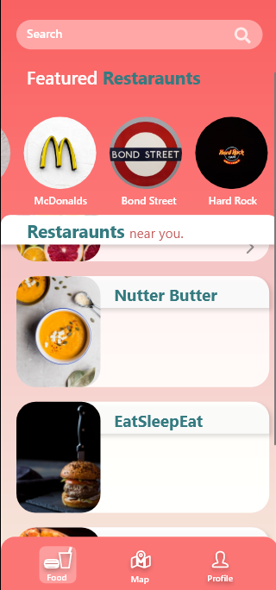
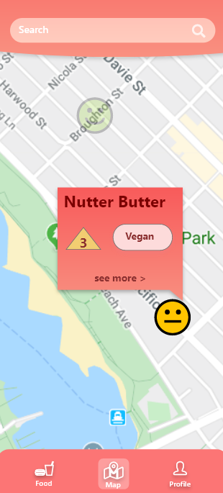
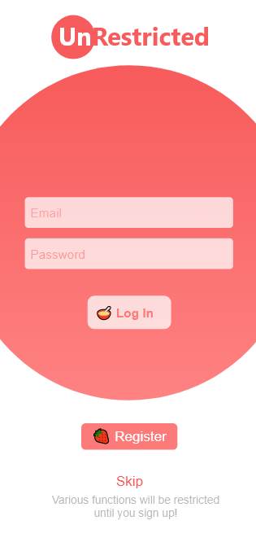
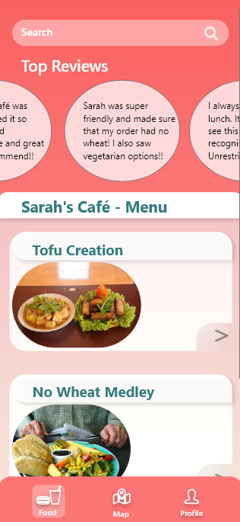
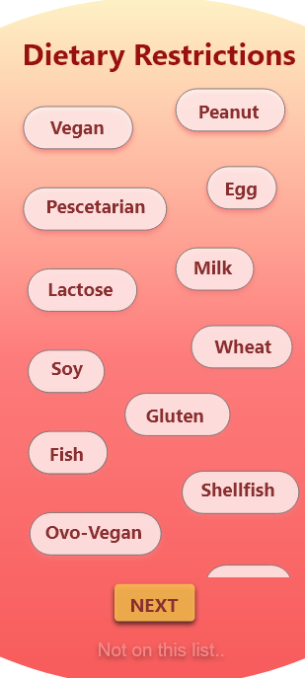
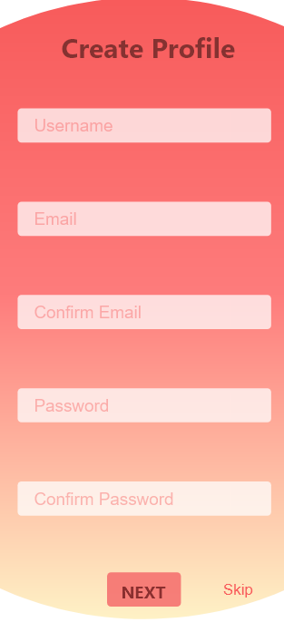
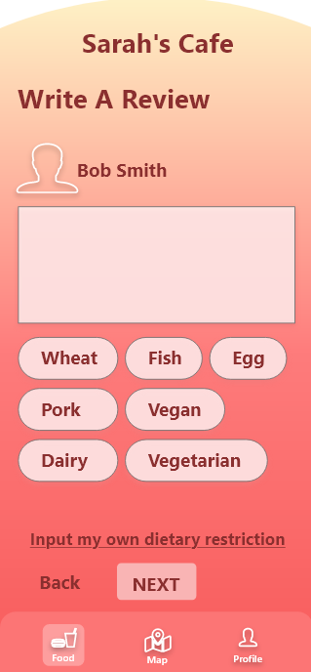
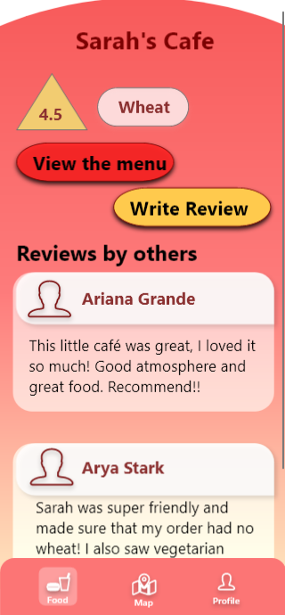
Restaurant
Menu & Reviews
Log In
& Sign Up
Discovery, Map & Search
Initial Hi-Fi Prototype

Slide 17
Heuristic Evaluation

Slide 18


Factors to improve
User Control and Freedom
Addition of back buttons on every page would increase usability.
Profile page for user to view and edit information
Help and Documentation
Provide help page with information on how to use the application.
Error prevention
Display appropriate error messages and solutions to the problem.

Slide 19
Factors to improve
Visibility of the system
Clarity on what the rating means was needed
Match between system and the real world
Implement “Save” or “Finish”
Flexibility and Efficiency of use
Allow user to edit profile information

Slide 20
What we did well!
Aesthetic and Minimal Design
Minimal and less clutter
Change colour of buttons for aesthetics
Recognition rather than Recall
Provide help page with information on how to use the application.
Consistency and Standard
Navigation and language used was consistent throughout

Slide 21
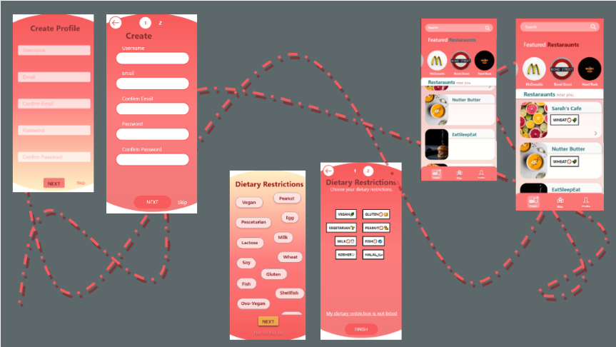
Improved Hi-Fi Prototype

Slide 22
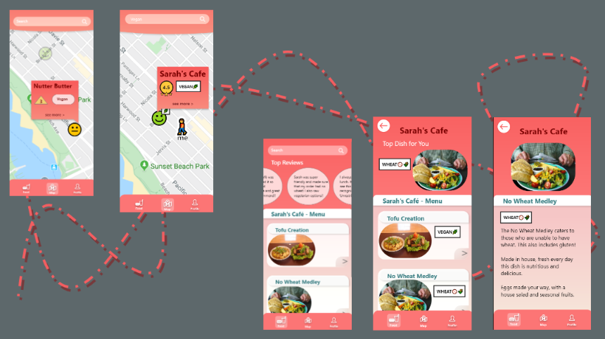

Slide 23
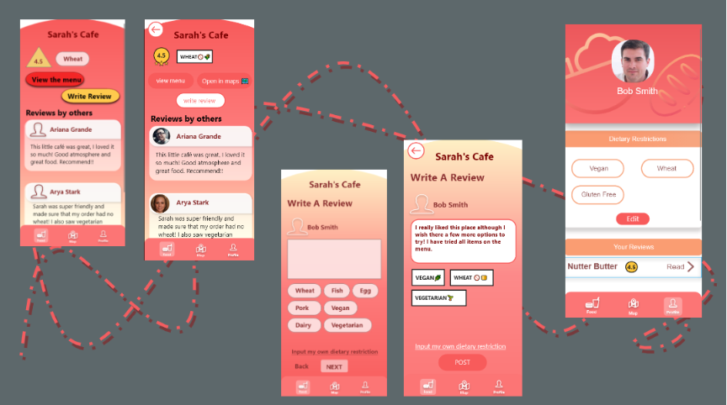

Slide 24
Feedback From Stage 4
Buttons need to be clear
Rating
Explore Page

Slide 25
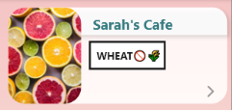
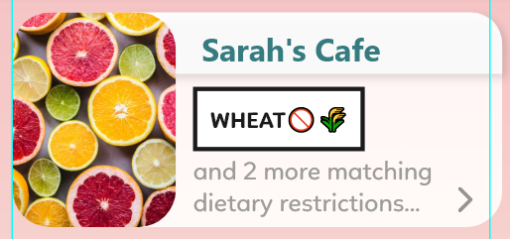
Explore page
Can fit and display multiple restrictions now!

Slide 26
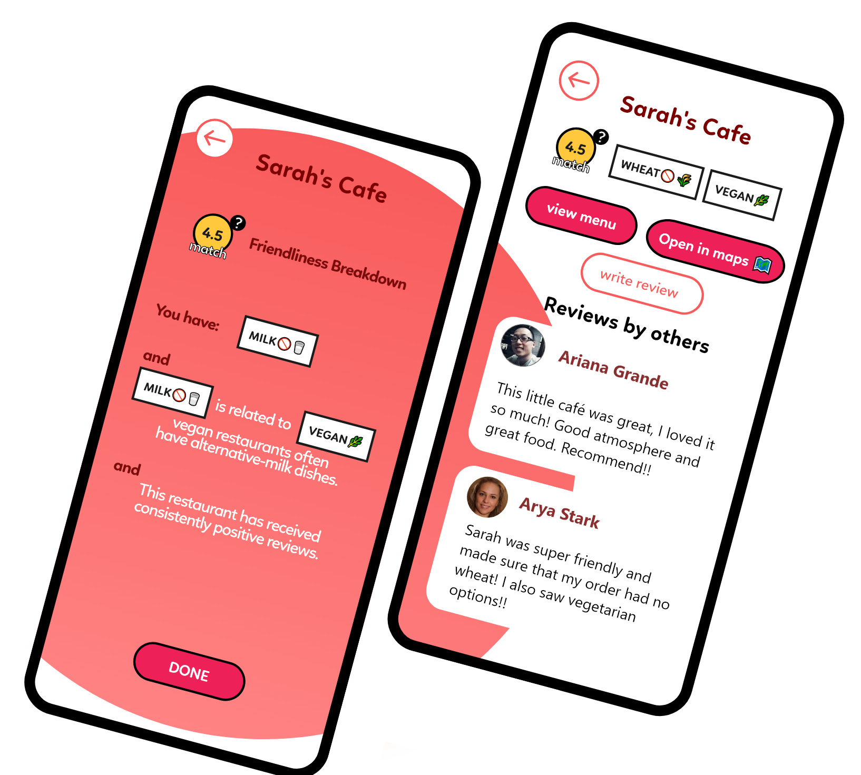
Clearer buttons
Clear Rating system
Added Educational aspect

Slide 27
Final Hi-Fi Prototype

Slide 28
Future Works
Expand on the educational aspect
Web-based application as well as mobile
Search based on everything (improve functionality)
Notes:
What else we could do with this app in the future:
Expand on the educational aspect, make it about teaching people what restrictions are and what food groups or specific foods those restrict
Make it a web-based application as well as mobile
Improve the functionality by allowing for all kinds of searches and matching it with the best/closest result

Slide 29
Thank You!
Questions, Thoughts, Concerns?

